Slide 1
My Top-10 in Spotify
File created on: 5/6/2024 7:36:04 AM

Slide 2
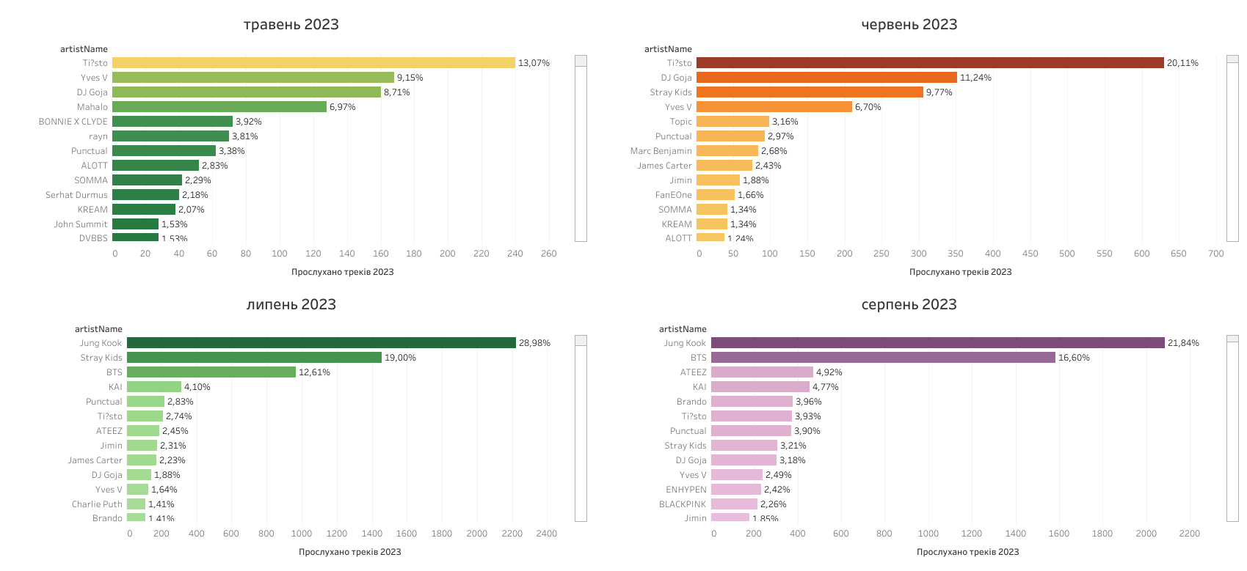

Slide 3
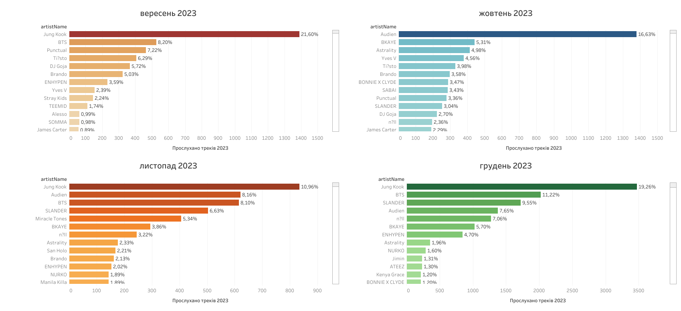

Slide 4
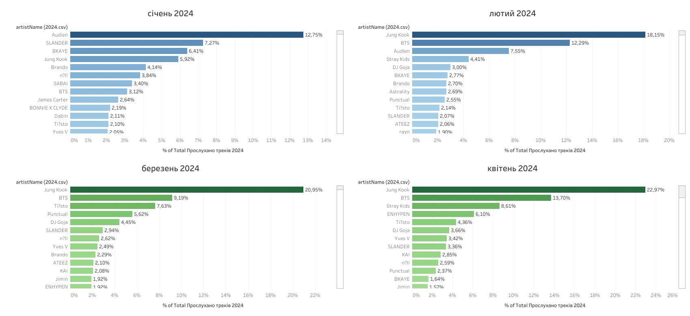

Slide 5
